Slide 1

Online Exam System
This presentation outlines the design and implementation of a modern online exam system. We will leverage Spring Boot for the backend, MySQL for data storage, and Angular for the user interface.
Presented By: Brahmaiah
LakshmiNarayana
Niharika
Yogeshwari
Hephzibah Kovila

Slide 2
Introduction:
Accessibility
Cost-Effectiveness
Students can take exams from anywhere with an internet connection. It can be accessed from any device.
Reduced costs associated with printing and manual grading. Saving paper and resources.

Slide 3

Why Online Examination
Web Based Management System which is reliable
Automation of Examination
Flexible Assessments
Time Saver
Auto Result
Easily Create

Slide 4
SCOPE:
Online Exam System can be used by Educational institutes like school, colleges and private institutes
to conduct exams of their students or employees on regular basis.
Online Exam System can be used for skill tests, behaviour tests while corporate hiring.
Can be used anywhere any time as it is a web application.
Design to facilitate Admin and User.

Slide 5

OBJECTIVES :
Online Platform
Provide an online platform for conducting exams with ease.
Secure Access
Implement secure authentication and authorization protocols.
Admin & Student Roles
Allow Admin to create exams and Students to attempt them online.
Automated Results
Automate result generation and streamline data management.

Slide 6




Features OverView :
Students
Admins
Authentication
Register, take exams, and view results instantly after completion.
Create/edit exams, add questions, and manage student data.
Secure login and registration process for all user roles.

Slide 7



System Architecture: A Three-Tier Approach
Presentation Tier
Angular-based user interface for student and admin interactions. Front end technologies.
Application Tier
Spring Boot REST APIs handles logic, Java and Spring.
Data Tier
MySQL database stores exam data, questions, and results. Secure and reliable data.

Slide 8
Technology Stack :
Frontend
1
Angular, TypeScript, Bootstrap for interactive UI.
2
Backend
Spring Boot, Java, Spring Security, REST APIs for server-side logic.
Database
3
MySQL for efficient data storage and retrieval.

Slide 9




DataBase Schema
Users
Test
Manages students and Admins.
Stores Exam Details.
2
Test Results
Questions
Stores all the exam Results.
Stores all the question data.

Slide 10

ADMIN :
Admin will login into the website
Admin will create test
Admin will upload questions based on the levels
Admin will set time for the exam
Admin will set marks for the exam

Slide 11
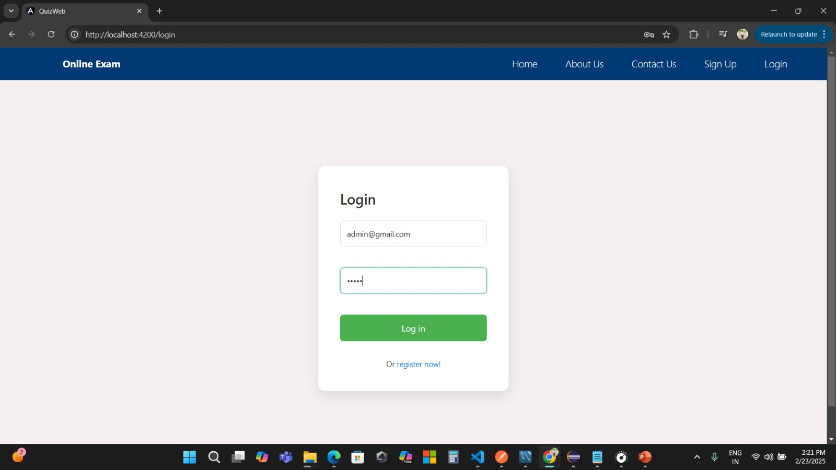
1. Securely Login With Admin Credentials

Slide 12
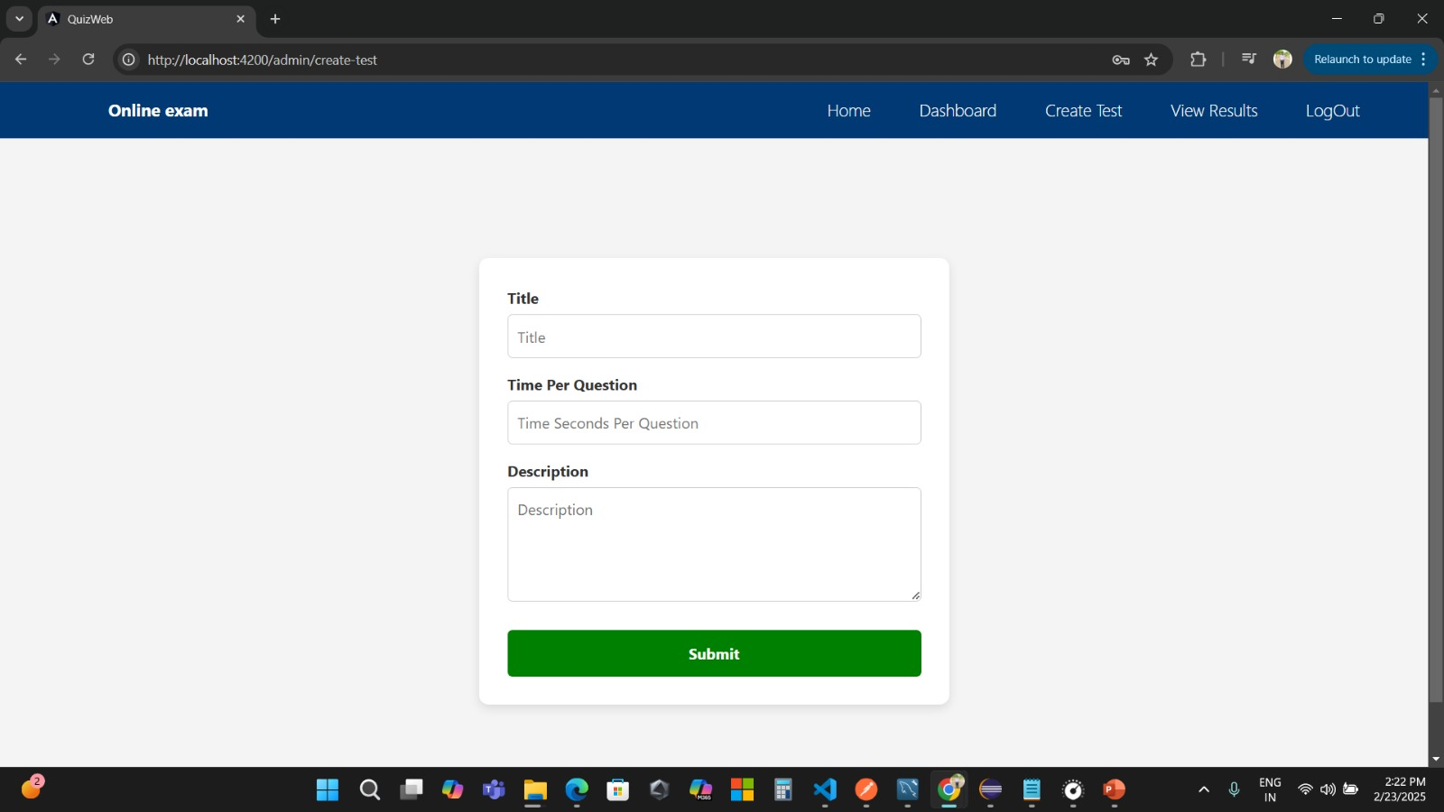
2. Set the Title and Exam Time Per Question

Slide 13
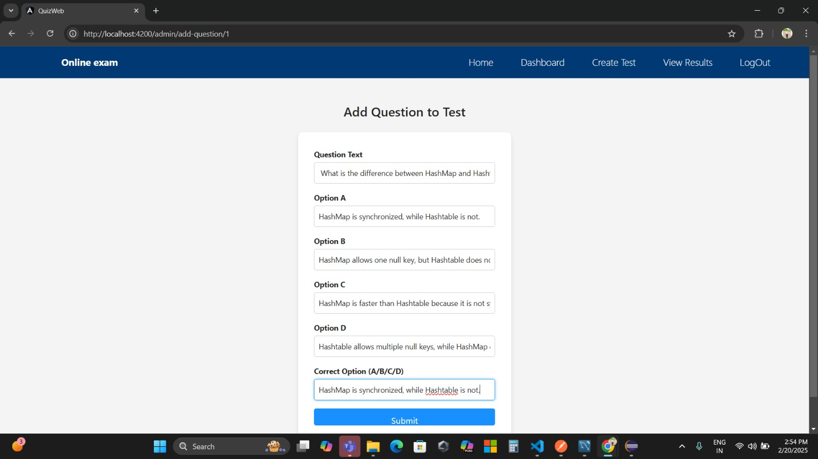
3. Upload Questions to Test

Slide 14
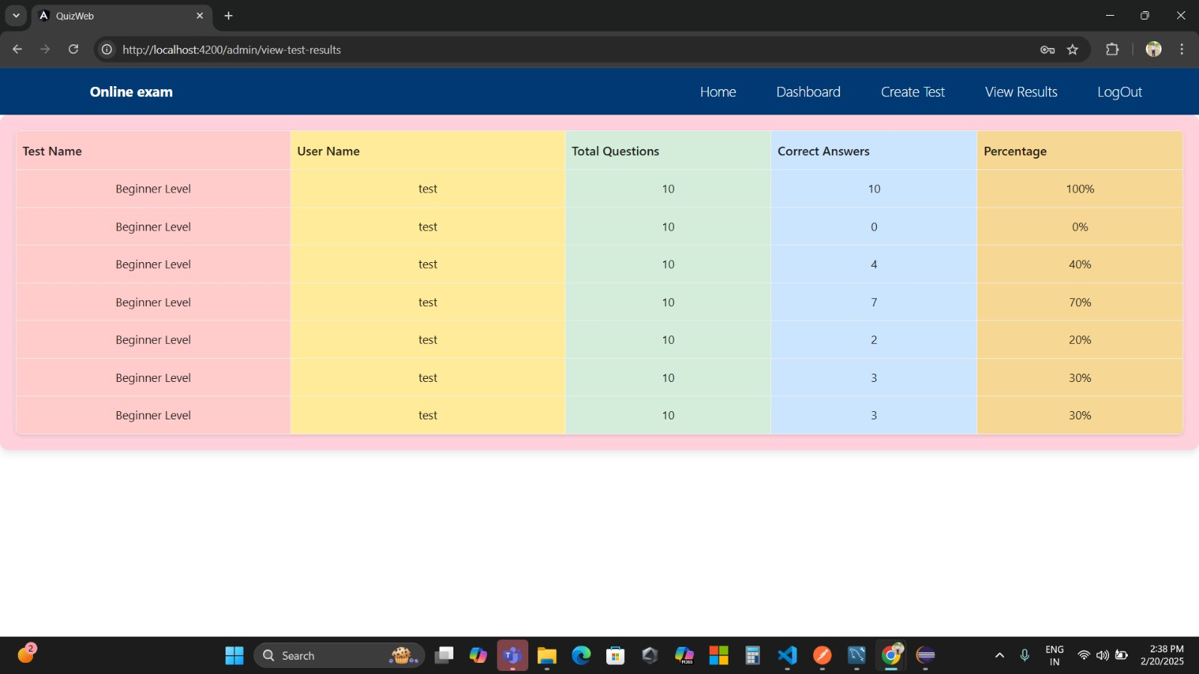
4. Admin can View the Results

Slide 15
USER :
User will login, attempt questions , finish the exam and view the results.

Slide 16
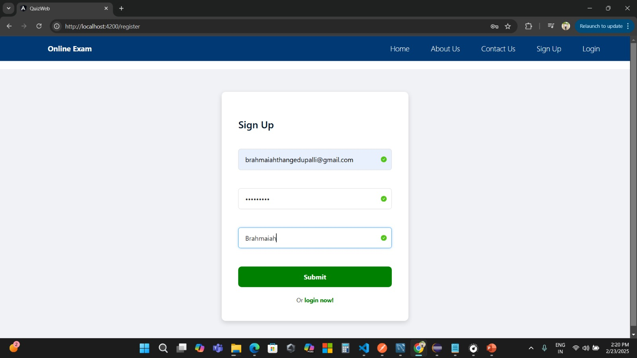
1. Securely Login With User Credentials

Slide 17
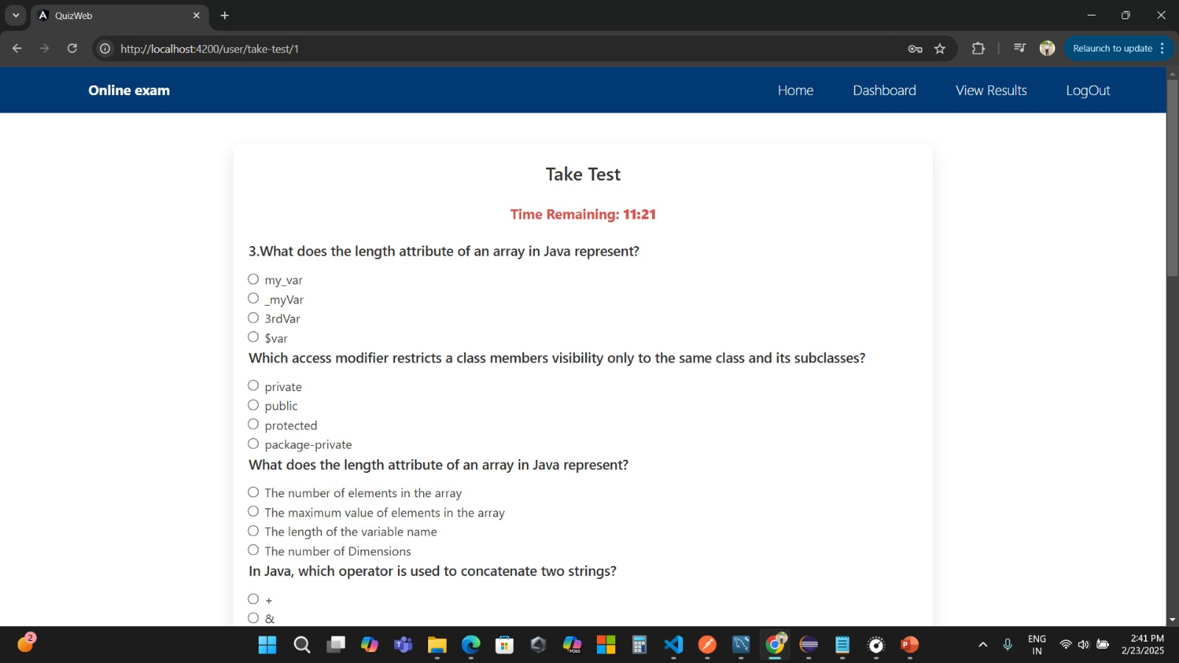
2. User can Attempt the Exam

Slide 18
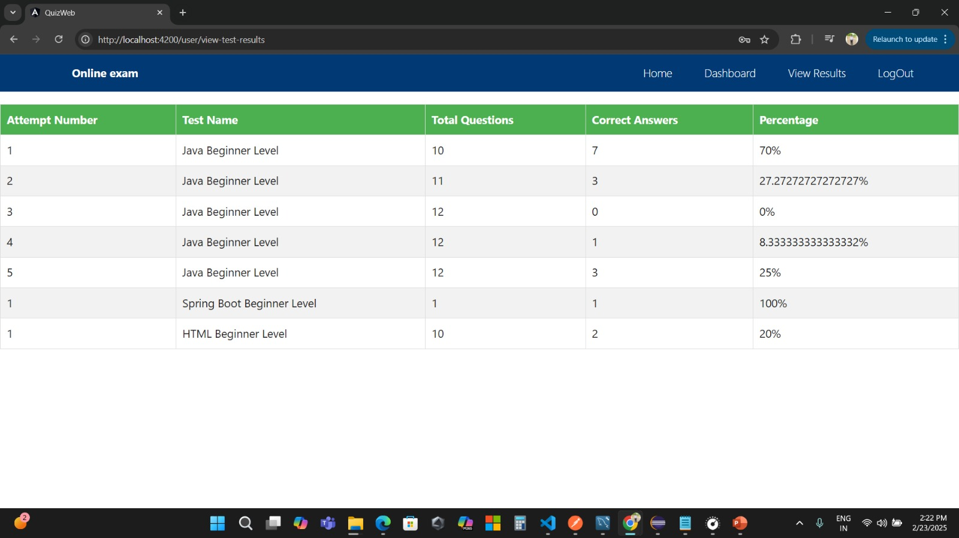
3. User Can View the Results

Slide 19



Conclusion: Benefits and Future Enhancements
Enhanced Learning
1
Adaptive learning paths.
Improved Evaluation
2
Reliable and secure exams.
Streamlined Processes
3
Efficient question management.
Modern online exam system offers numerous benefits. The system is poised for future growth. It also provides adaptive learning paths and personalized feedback.

Slide 20
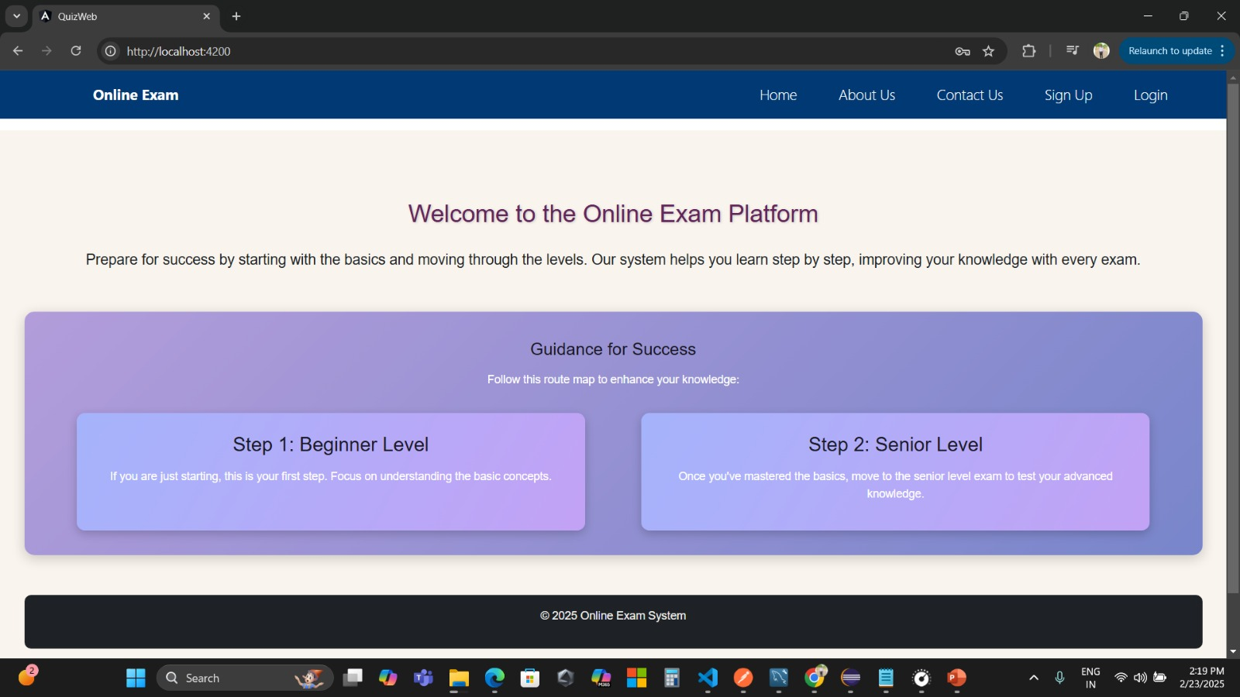
SCREENSHOTS:
1. Home Page :

Slide 21
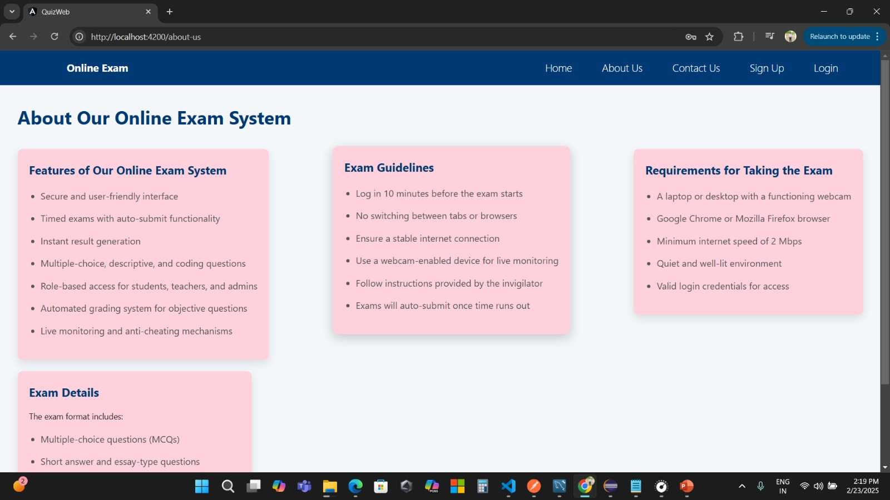
2. About Us Page :

Slide 22
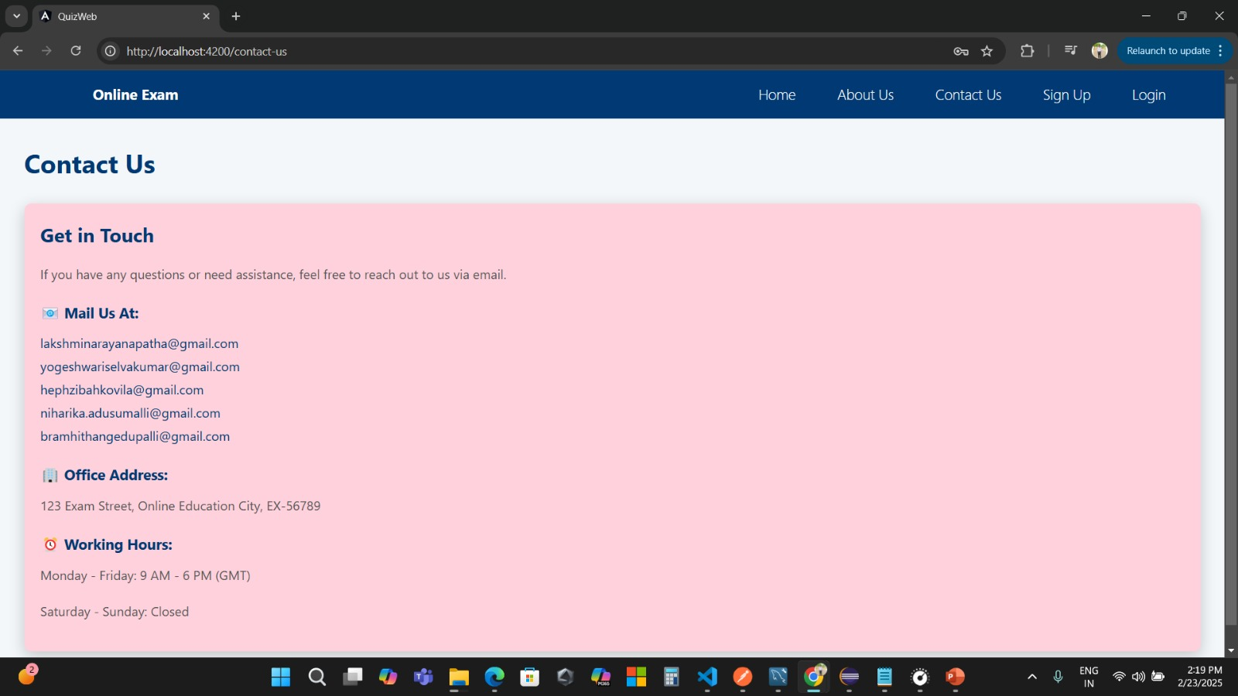
3.Contact Us Page :

Slide 23
4. Sign Up Page :

Slide 24
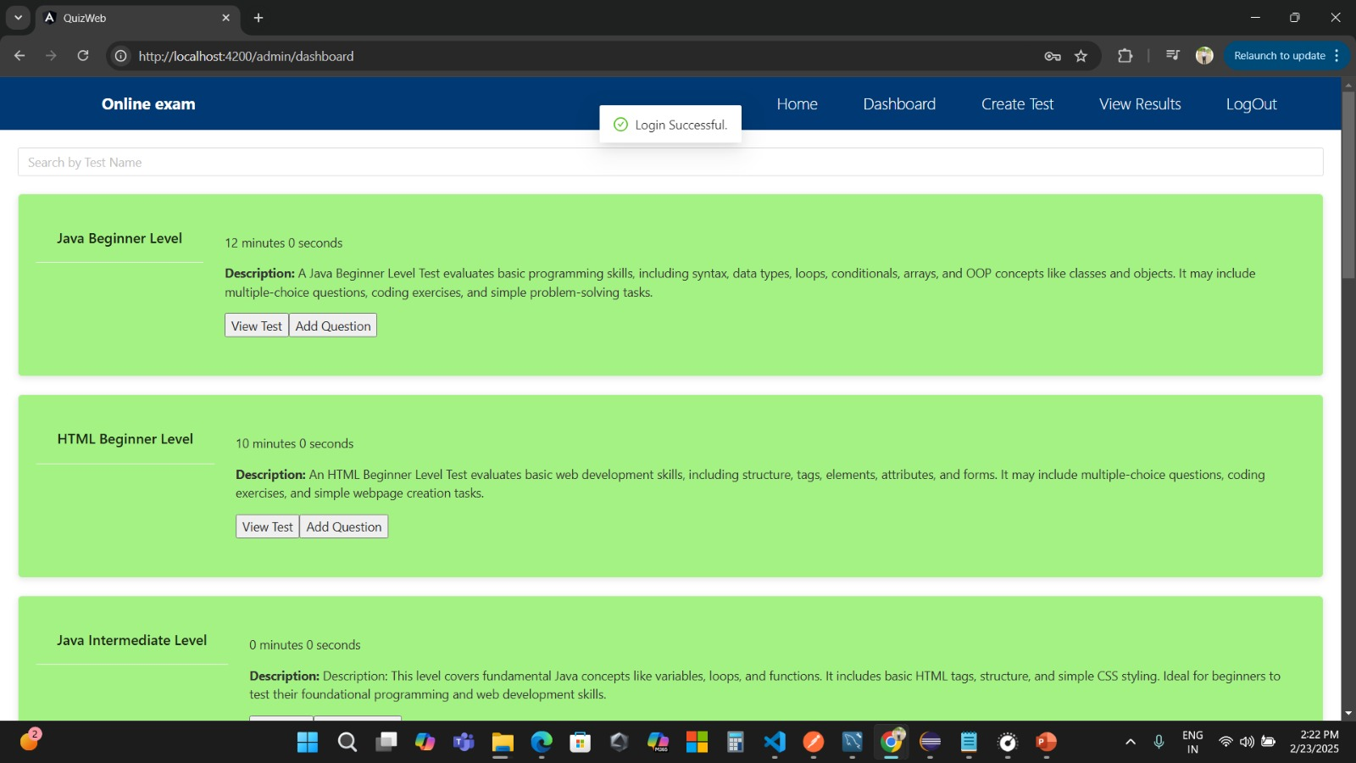
5.Admin DashBoard Page :

Slide 25
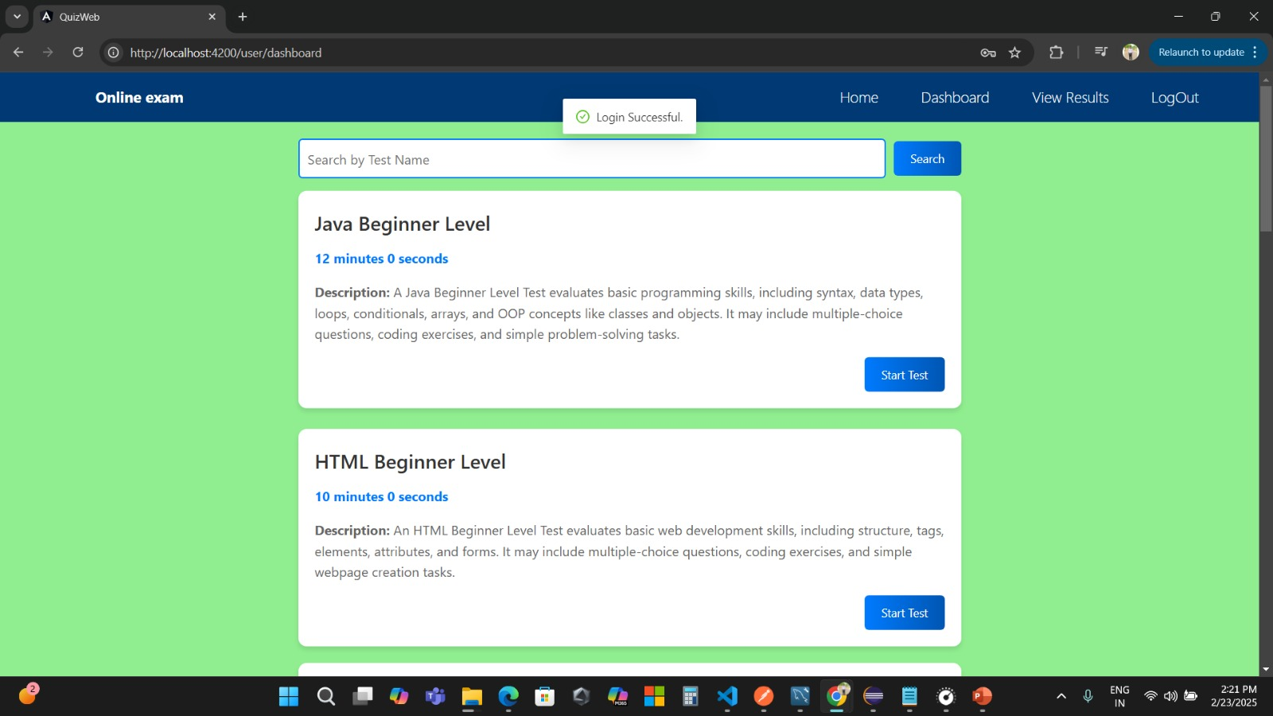
6. User Dashboard Page

Slide 26


